Slide 1
DHRUVA SHIPPING CONSULTATS AND SERVICES PVT. LTD.

Slide 2
Shipbuilding Process
Discussion on Owner’s Technical Specification and Agreement.
Basic Design and Detailed Design.
Class Approval for all Hull/Electrical/Piping drawings and designs
Production Drawings ground level working
Indenting of machinery according to Specs & Class Requirements
Finalization of P.O.
Unit/Block wise Production Process.
Pre-Commissioning checks of Various System
Commissioning of Various System
Basin Trial
Sea Trial
AS BUILT drawing Preparation

Slide 3
Shipbuilding Process
Owner’s Technical Specification
Approved structural drawings and designs
Indenting of machinery according to Specs & class requirements
Finalization of P.O.

Slide 4
Preparation of working drawings
SLD
IWD
TRAY & HANGER
LAYOUTS
Penetration
layout
Cable schedule
Trial Protocol
Signal Interfacing Drawings
Production According to working drawings

Slide 9
Pre-commissioning Checks for Electrical System
Cable Continuity
Testing &
Termination
Checking
Calibration Of Instrumentation
Insulation test of Motors
and Alternators
Cold Checks for Various Systems
P/R switches
Temp Switches
Electrical Test and Trials
Basin Trials
Sea Trials
Generator Trials
All alarm checking
Main Switch Board Testing etc..
UMS – Notation Sea Trial
Endurance Trial
Speed Trial
Steering & Maneuvering etc..

Slide 10
Electrical Hot work Drawings :-
Cable tray and hanger layout:- This drawing gives dimensional details for fabrication of tray and hanger route on deck ceiling, bulkheads.
Panel Disposition Drawing:- This drawing indicate all deck wise panel location throughout the ship, as well as for each panel we are providing drawing for all three views .
Cable Penetration details/layouts:- This drawing indicate all deck wise Cable penetration dimensional details throughout the ship. Also we will take care of Hull Compensation required to be given near each Cable Penetration.

Slide 11
Case Study for Electrical hot work drawings
No need to cross check with other activity of Hull, Piping, Ducting and Ventilation required.
Very less amount of Rework in Hot Work Stage for Cable Tray and Hanger
By using this drawing one can start Unit/Block wise Production Process simultaneously
Collectively all this will increase the Production Rate.
As we are reducing Rework Quantity. Wastage of material as well as Man hours can be saved.
With the help of Cable Tray and Hanger layout Drawing and Panel Disposition drawing one can easily complete maximum amount of Hot Work Required for Cable Laying with reference to time factor.
Each and every Panel “Seating Arrangement” can be fabricated separately as we are having for all three views dimensional drawings for that particular panel.
Using this drawing we can calculate total quantity of cable penetration throughout the ship as well as deck wise quantity and we can easily keep track in this stage.
Each and every Cable Penetration can be fabricated separately as we know the exact quantity and dimension for each penetration.
With the help of Cable Tray and Hanger layout Drawing , Panel Disposition drawing and Cable penetration drawing one can easily calculate the shortest cable route for each system as well as total cable quantity required for complete ship cable laying.

Slide 15
Case Study for Master Cable List/ Total Cable Schedule
This List specify all system wise Cable details and cable types throughout the ship.
Each Cable will be given an Unique identification Tag, which is very easy to correlate.
By using this List one can start Unit/Block wise Cable Laying Process simultaneously.
Using Master Cable list we can easily keep track on various system cable laying process.
In this list `Cable Type` is mentioned for every cable. One can estimate tentative cable quantities for various types of cables, this will avoid eleventh hour delay in cable laying
One can avoid repeat cable laying easily.
As in this list all cables are included so further rework in cable laying can be avoided.
Master Cable List will make cable laying Stage very simple.
Collectively all this will increase Unit/Block wise Production Rate.
If the cable schedule is not available
Cable laying process will not be uniform as, one has to find out cables to be laid from manufacturer drawings, production drawings, which is time taking activity and it leads to manual errors.
Possibilities of rework are high, which disturbs correlated activity like accommodation ceiling clearance.
You can not work simultaneously in all units / blocks as you don’t have “To-From” locations for the cables.
Water tight glands/penetrations of the bulkheads may have to rework as no quantity of cables known initially.
All it is going to affect pace of the project ultimately along with wastage of man hours and material.

Slide 17
Termination Details for Major Systems
This drawing include cable`s core wise termination detail of both side of the cable
for termination purpose. We prepare this drawings mainly for Main Engine,
Propulsion System, DP System, Steering Gear System etc.
This Drawing is very much helpful for ground level working people i.e. Production Engineer, Supervisor, Electrician ect.
With this drawing, one can keep track on cable laying of respective system.
This drawing show Inter Facing Cable and their termination details of both the end. i.e. Main Engine and Propulsion System Interface, Main Engine and Main Switch Board Interface. ect.
These drawings will speed up panel termination work rate with accuracy.
If the termination details for the system are not available
If you say that these details are provide in manufacturer’s drawing, then yes but in their format it won’t helps to production purpose as manufacturer won’t consider other end of the system.
Interface with other systems and in required sense is not mentioned.
Not readable to unskilled or semi skilled labour e.g. Electricians.

Slide 19
Technical Specification Reading and Extraction of Electrical Points
Technical specification reading and extraction of required points for each ship before starting production is very much important stage in New Shipbuilding.
This will give you clear idea for Material Indenting.
Some Special clauses/Owner Requirements will be noted down well before so that later delay can be avoided.
In some layout drawing(E/R layout, W/H layout, Consoles layout)/ compartment arrangements owner`s approvals required, same can be noted down well advance.

Slide 21
Power Management System
Power Management system is integrated system for generation and distribution plant.
In which requirement of power is fulfilled with the combination of one or two generators.
Also combination of generating plant, according to the mode of operations for e.g DP mode, Fi-Fi mode, Maneuvering mode , sailing mode etc.
For this integrated system to work generation plant has to set accordingly, with the help of required instrumentation.
Dhruva can work for the same to set the Power Management System.

Slide 22
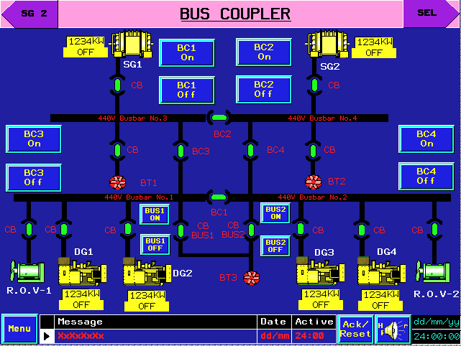

Slide 23
Vessel Management System
Vessel Management system is also an integrated system with so much of instrumentation and controllers , which comprises of central alarm system, pump and valve controls, tank gauging system, cargo handling system.
As the system controls the whole ship through required instrumentation inputs, cable laying and termination quantum is high.
Precommissioning checks are an important stage in such a system which can be taken over by Dhruva, which includes loop checking, calibration of sensors.
Central alarm system for the ship is also included in this system, I/O list for which also can be prepared according to class requirements and owner’s specification ,loop checking of cables for the system can be done.

Slide 24
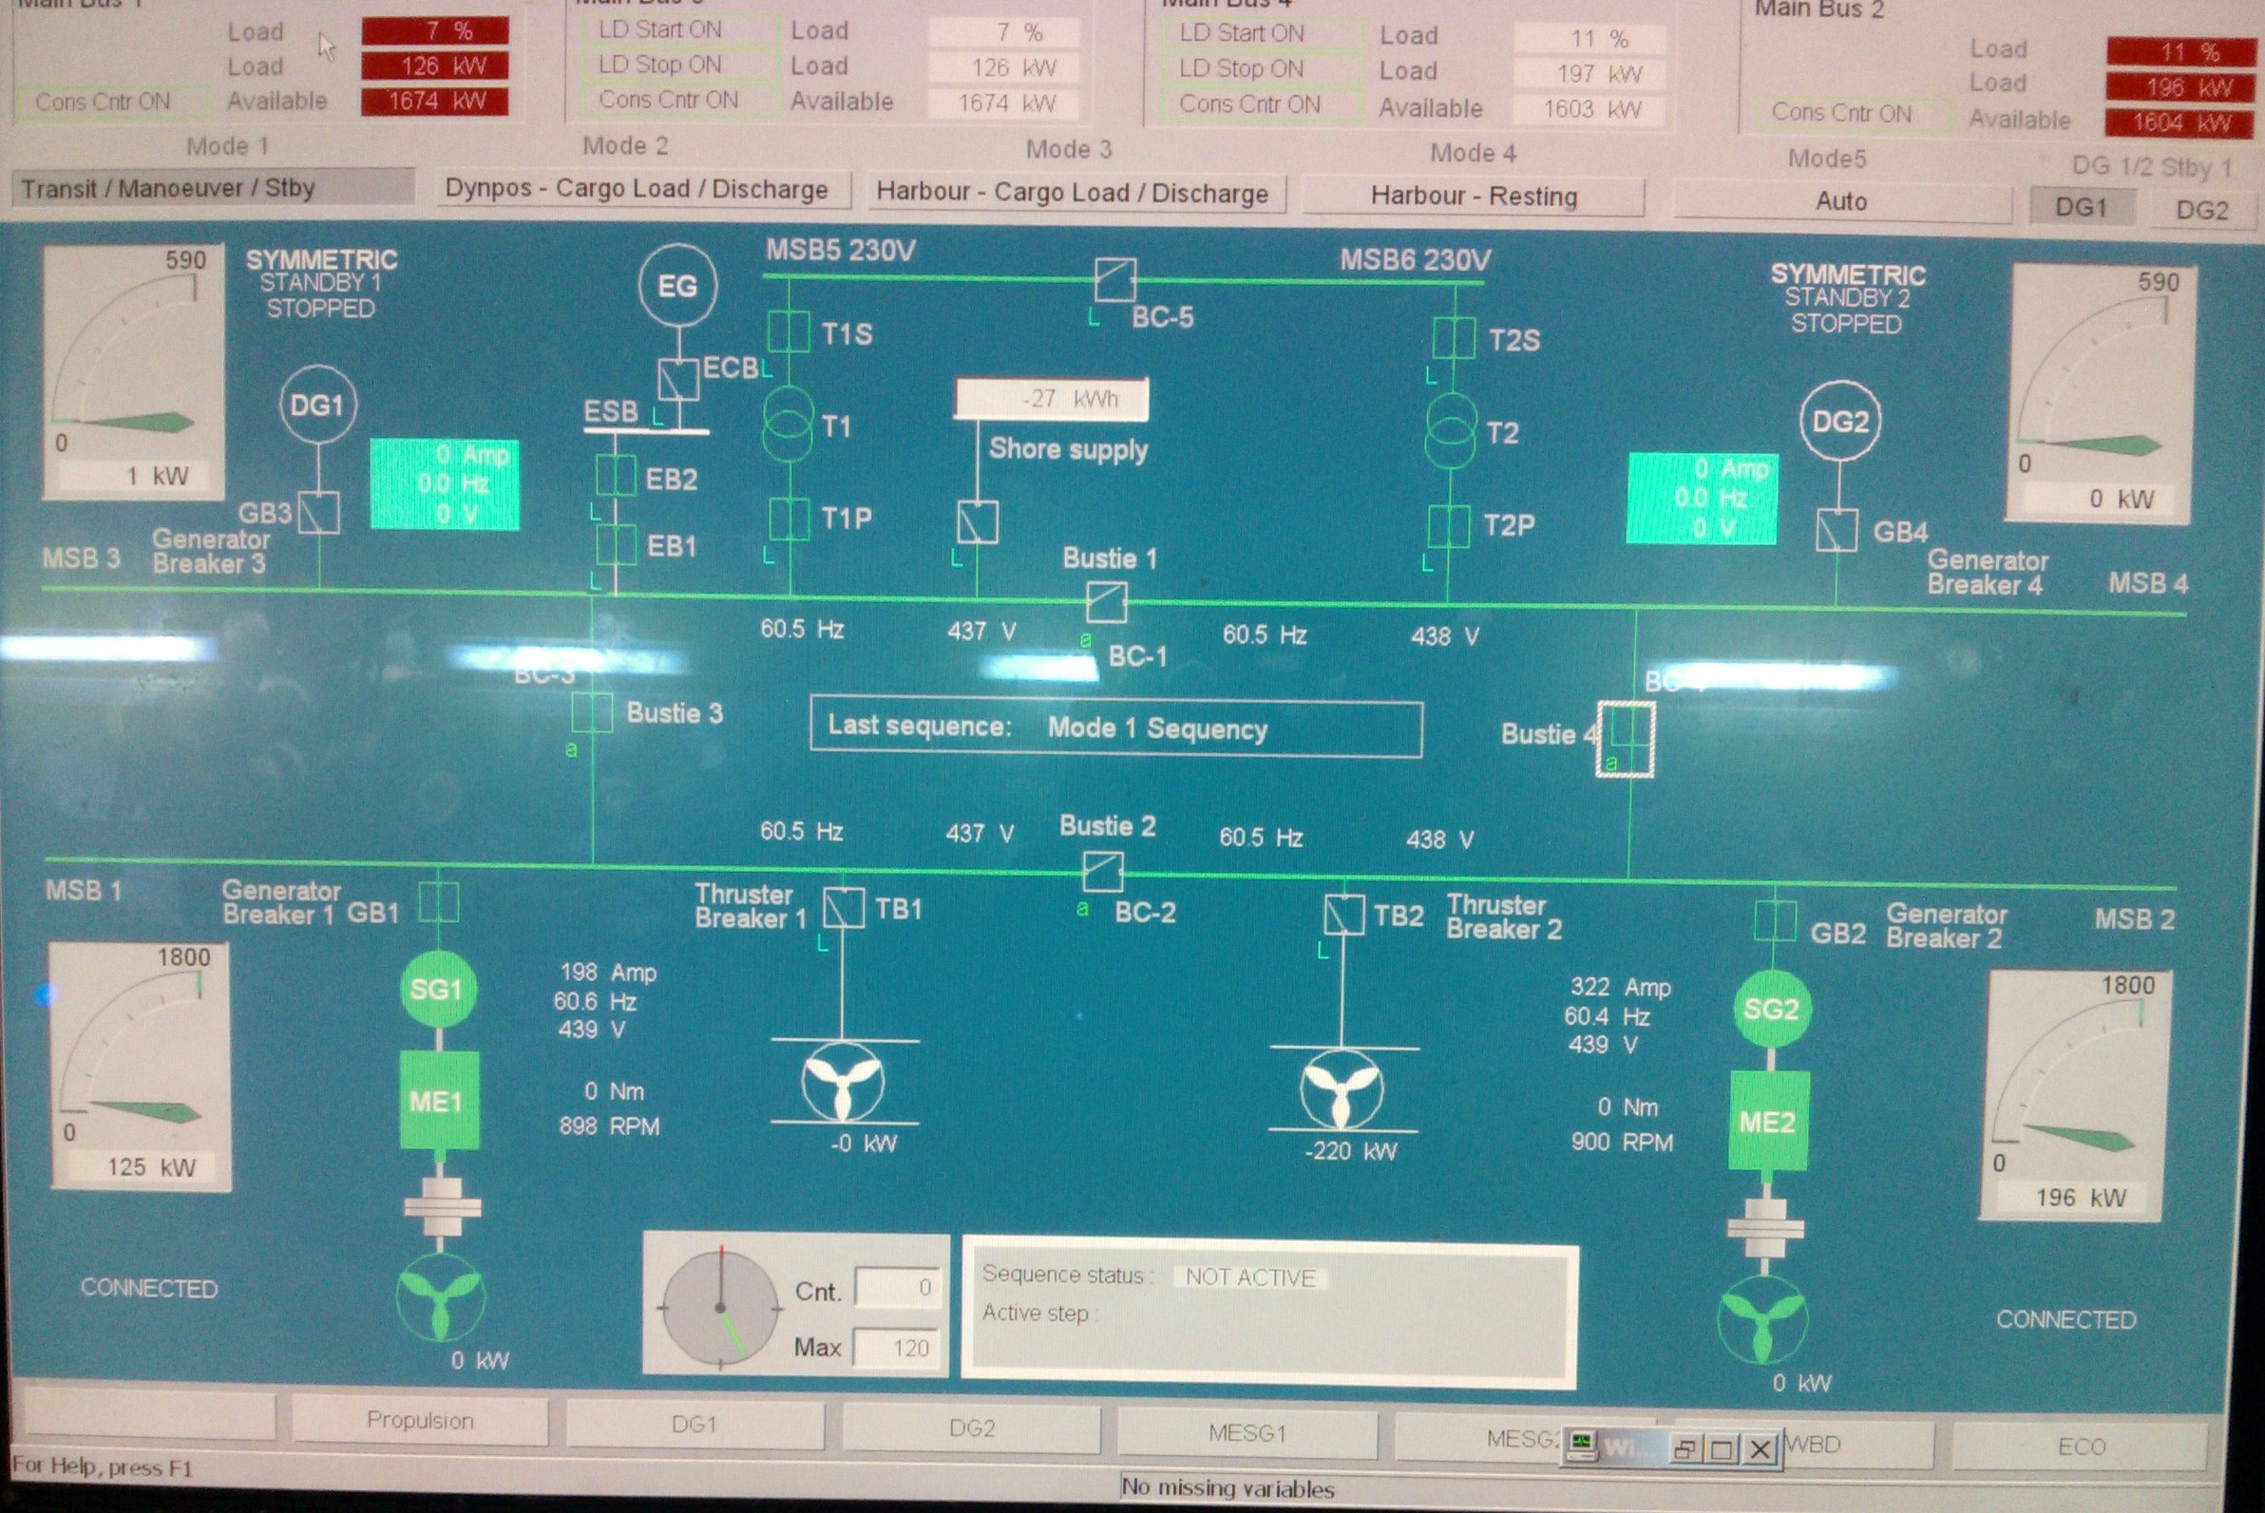

Slide 25
Dynamic Positioning System and FMEA
Dynamic positioning system is a Supervisory controlled navigating system ,which maintains vessel position.
In this system number of navigational equipments, propulsion systems, Power generation system are interfaced with each other.
It requires substantial amount of cable laying.
Loop checking for this system along with fulfilment of interface requirements can be carried out by Dhrua.
Consultation regarding Failure Modes and Effect Analysis (FMEA).

Slide 26
AS BUILT drawing Preparation
During hot work stages few onsite changes being done, same need to be incorporated in the respective drawing.
During Commissioning and trials of the system some minor changes need to be done in the cable laying and termination. Same has to be incorporated in the respective system drawing before delivery of the ship.
These drawings are very much helpful for next Sister ship.

Slide 27
THANK YOU
www.dhruvashippingconsultants.com

